Slide 1

Chaos in the Henon Heiles System
Hitesh Devalapelli, K Shreya Rao, Sasi Mitra Behara, SGM Rasheed

Slide 2
Introduction
The Hénon-- Heiles system is interesting because it exhibits chaotic behavior for certain initial conditions.
Chaotic behavior refers to a sensitive dependence on initial conditions, where small changes in the starting conditions can lead to drastically different trajectories over time.
This system has been extensively studied in the context of nonlinear dynamics and chaos theory. It has provided valuable insights into the nature of chaotic motion, bifurcations, and the transition to chaos in dynamical systems.
The Hénon- Heiles system serves as a fundamental example for understanding chaos and has applications in various fields, including physics, astronomy, and engineering.

Slide 3
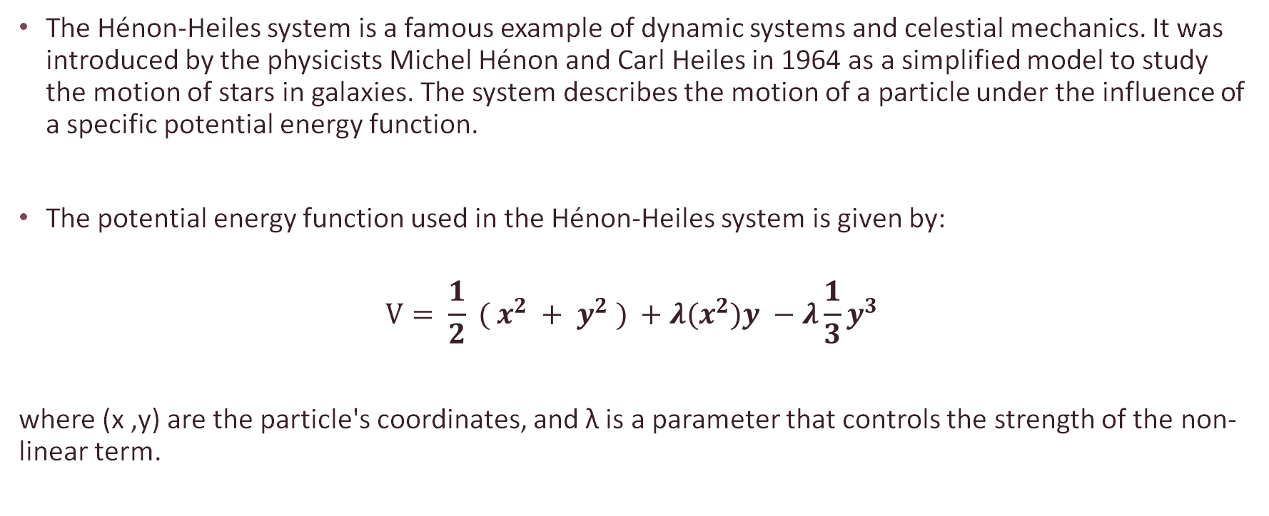
The Hénon-Heiles system is a famous example of dynamic systems and celestial mechanics. It was introduced by the physicists Michel Hénon and Carl Heiles in 1964 as a simplified model to study the motion of stars in galaxies. The system describes the motion of a particle under the influence of a specific potential energy function.
The potential energy function used in the Hénon-Heiles system is given by:
$$V= \frac{1}{2} ( x^{2} + y^{2} ) +λ(x^{2})y −λ\frac{1}{3}y^{3}$$
where (x ,y) are the particle's coordinates, and λ is a parameter that controls the strength of the non-linear term.

Slide 4
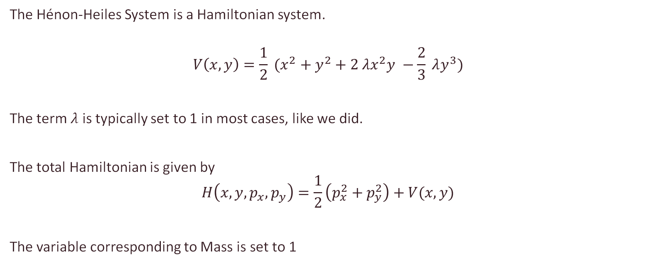
Hénon Heiles System
The Hénon-Heiles System is a Hamiltonian system.
$$V\left(x,y\right)=\frac{1}{2} (x^{2}+y^{2}+2 λx^{2}y −\frac{2}{3} λy^{3})$$
The term $λ$ is typically set to 1 in most cases, like we did.
The total Hamiltonian is given by
$$H\left(x, y, p_{x}, p_{y}\right)=\frac{1}{2}\left(p_{x}^{2}+p_{y}^{2}\right)+V(x,y)$$
The variable corresponding to Mass is set to 1

Slide 5


Deriving the Equations of Motion
The Equations of Motion can be derived from the Hamilton’s Equations of Motion
$$\frac{d}{dt}p_{i}=−\frac{∂H}{∂ q_{i}}$$
$$\frac{d}{dt}q_{i}=\frac{∂H}{∂ p_{i}}$$
We obtain the following four time-derivative for our Four Variables.
$$\dot{x}=p_{x}$$
$$\dot{y}=p_{y}$$
$$\dot{p_{x}}=−x −2xy$$
$$\dot{p_{y}}=y^{2}−y −x^{2}$$

Slide 6

Fixed Point Analysis
$\dot{x}=P_{x}$
$\dot{y}=P_{y}$
$\dot{P_{x}}=−2xy −x$
$\dot{P_{y}}=y^{2}−y −x^{2}$
The fixed points are : (x ,y , $P_{x}$, $P_{y}$) = ( 0, 0, 0, 0) ,(0, 1, 0, 0), ($\frac{√3}{2}$, $−\frac{1}{2}, 0 , 0),$ and ( -$\frac{√3}{2}$, $−\frac{1}{2}, 0 , 0$).
The Jacobian Matrix is calculated to be:

Slide 7
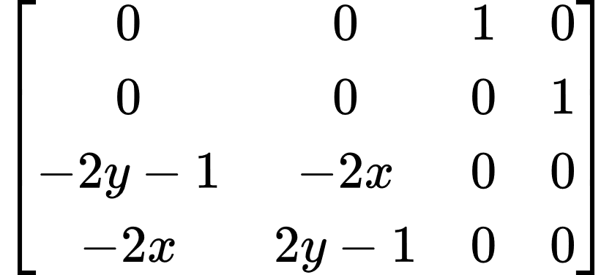
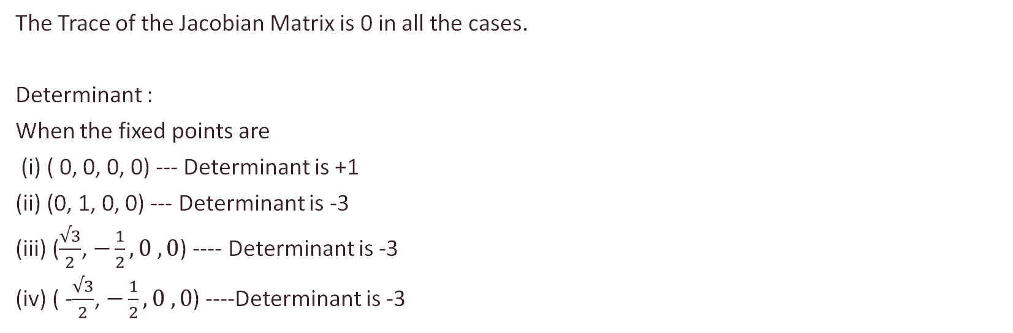
The Trace of the Jacobian Matrix is 0 in all the cases.
Determinant :
When the fixed points are
(i) ( 0, 0, 0, 0) --- Determinant is +1
(ii) (0, 1, 0, 0) --- Determinant is -3
(iii) ($\frac{√3}{2}$, $−\frac{1}{2}, 0 , 0$) ---- Determinant is -3
(iv) ( -$\frac{√3}{2}$, $−\frac{1}{2}, 0 , 0$) ----Determinant is -3

Slide 8

Now let’s calculate the stability of the fixed points using Trace and Determinants :
If the determinant is negative, it is a saddle point, and if the Determinant is positive and the Trace is 0, it is a center.
When the fixed points are
(i) ( 0, 0, 0, 0) --- Determinant is +1 ---- Trace = 0 ----- Linear center
(ii) (0, 1, 0, 0) --- Determinant is -3 ---- Trace = 0 ------ Saddle node
(iii) ($\frac{√3}{2}$, $−\frac{1}{2}, 0 , 0$) ---- Determinant is -3 ---- Trace = 0 ------ Saddle node
(iv) ( -$\frac{√3}{2}$, $−\frac{1}{2}, 0 , 0$) ----Determinant is -3 ---- Trace = 0 ------ Saddle node

Slide 9
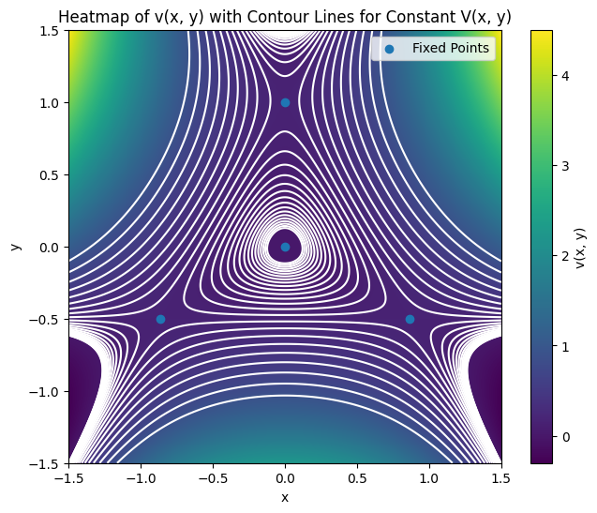
Comparison with the Potential Heatmap
We have calculated the Heatmap as a function of position here :
The white lines visible are the constant energy trajectories.
As we have seen for case – (i), there are white lines making closed loops around the center, but for cases (ii), (iii), and (iv), we can see that these lines are diverging, making it a saddle point in stability analysis.

Slide 10
KAM Theorem
The KAM (Kolmogorov-Arnold-Moser) theorem is a fundamental result in the study of dynamical systems, particularly in classical mechanics and nonlinear dynamics. It deals with the persistence of invariant tori in Hamiltonian systems under small perturbations. These invariant tori correspond to regular, non-chaotic motion of particles in phase space.
The theorem states that for a certain class of Hamiltonian systems with nearly integrable dynamics (i.e., systems close to integrable ones), invariant tori survive under small perturbations. This means that these tori still exist even when the system is perturbed slightly, and the dynamics near them remain regular.
The theorem has been applied to celestial mechanics, particularly in studying the long-term stability of planetary orbits. By considering the solar system as a Hamiltonian system with multiple interacting bodies, researchers have utilized the KAM theorem to investigate the persistence of stable orbits over millions of years despite perturbations from other celestial bodies

Slide 11
Relation between KAM Theorem and Henon-Helies
The Hénon-Heiles system is a specific example of a dynamical system to which the KAM theorem has been applied. It describes the motion of a particle in a two-dimensional potential field and has been extensively studied as a model for celestial mechanics and other physical systems.
The Hénon-Heiles system is interesting because it exhibits regular and chaotic behavior depending on its parameters. The KAM theorem helps in understanding the transition from regular to chaotic behavior in such systems. By analyzing the system's Hamiltonian and the perturbations applied to it, one can determine the conditions under which invariant tori persist and when chaotic behavior emerges.

Slide 12
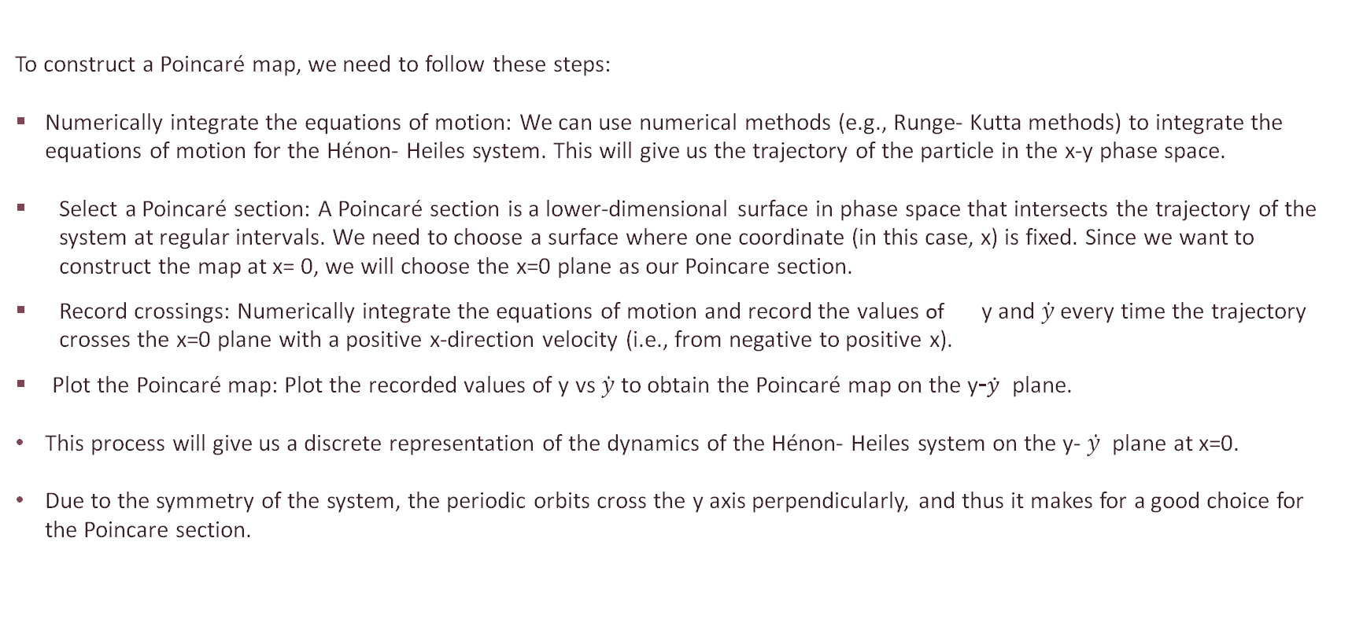
Construction of Poincare maps
To construct a Poincaré map, we need to follow these steps:
Numerically integrate the equations of motion: We can use numerical methods (e.g., Runge- Kutta methods) to integrate the equations of motion for the Hénon- Heiles system. This will give us the trajectory of the particle in the x-y phase space.
Select a Poincaré section: A Poincaré section is a lower-dimensional surface in phase space that intersects the trajectory of the system at regular intervals. We need to choose a surface where one coordinate (in this case, x) is fixed. Since we want to construct the map at x= 0, we will choose the x=0 plane as our Poincare section.
Record crossings: Numerically integrate the equations of motion and record the values of y and $\dot{y}$every time the trajectory crosses the x=0 plane with a positive x-direction velocity (i.e., from negative to positive x).
Plot the Poincaré map: Plot the recorded values of y vs $\dot{y}$ to obtain the Poincaré map on the y-$\dot{y}$ plane.
This process will give us a discrete representation of the dynamics of the Hénon- Heiles system on the y- $\dot{y }$ plane at x=0.
Due to the symmetry of the system, the periodic orbits cross the y axis perpendicularly, and thus it makes for a good choice for the Poincare section.

Slide 13

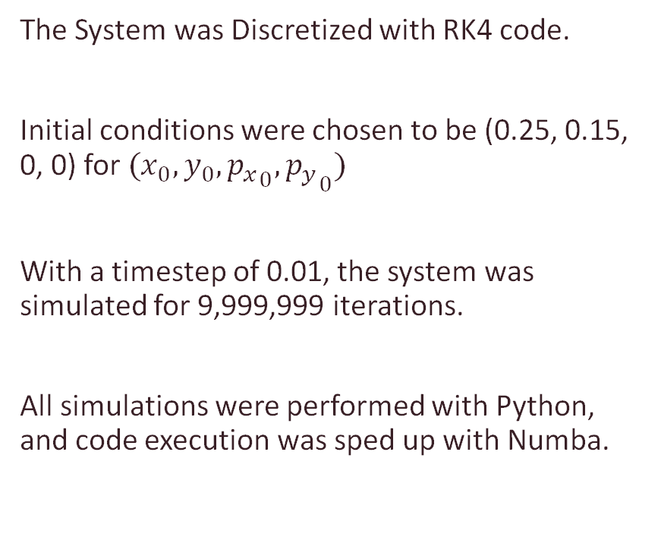
Numerical Calculations
The System was Discretized with RK4 code.
Initial conditions were chosen to be (0.25, 0.15, 0, 0) for $(x_{0},y_{0},{p_{x}}_{0},{p_{y}}_{0})$
With a timestep of 0.01, the system was simulated for 9,999,999 iterations.
All simulations were performed with Python, and code execution was sped up with Numba.
Once the trajectory was calculated, in order to make the Poincare map, the following condition was checked:
$x_{n}<0 and x_{n+1}>0$, then the corresponding average of the $y and \dot{y}$ was calculated and plotted in the Poincare map.

Slide 14
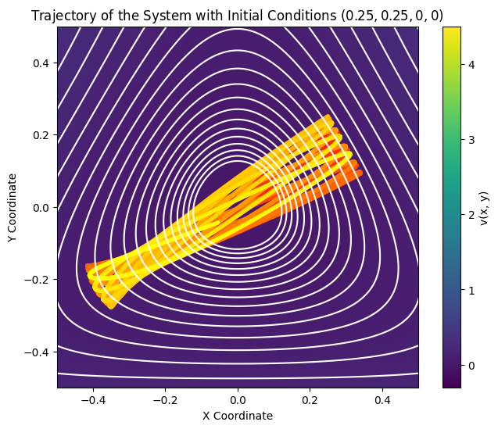
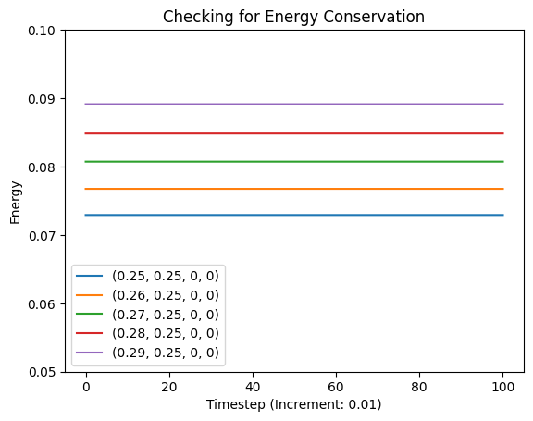
Results of Numerical Calculations

Slide 15
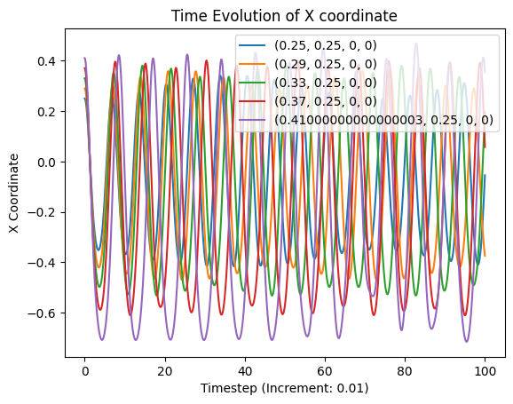
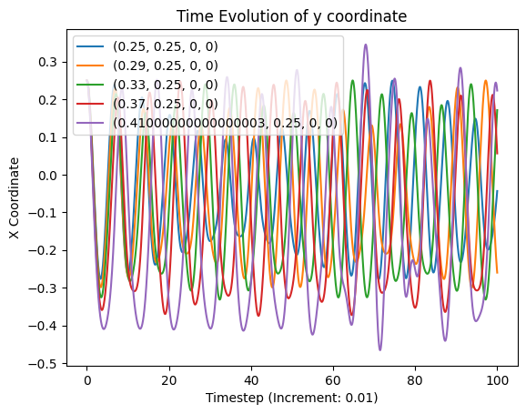
Results of Numerical Calculations

Slide 16
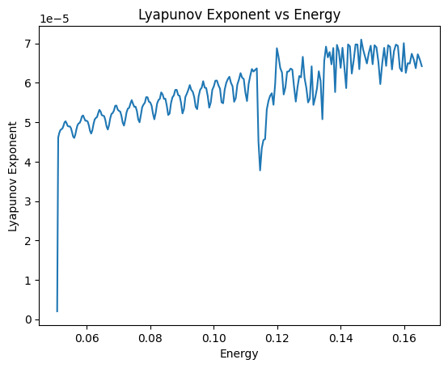
Results of Numerical Calculations
Lyapunov exponent of Poincare map

Slide 17
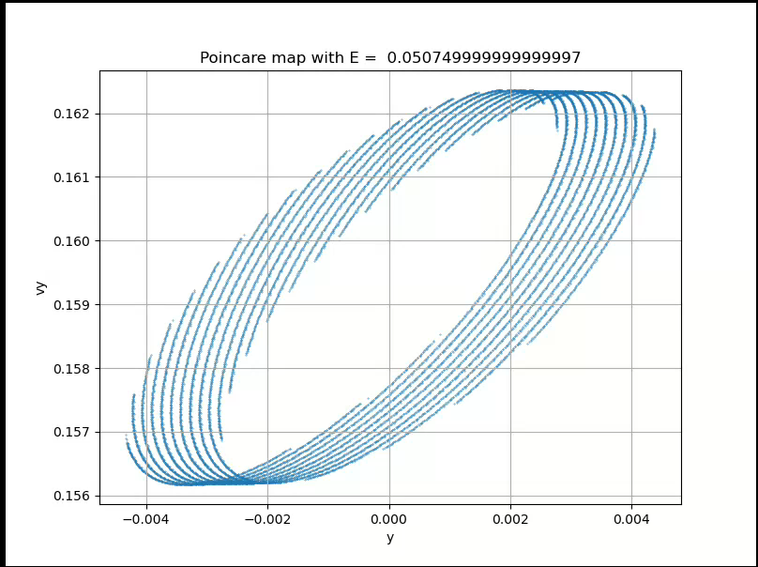
The Poincare Map
The System was Simulated for 240 Different Initial Conditions
The Poincare Map for each of the simulations was saved and then compiled into this GIF
The Poincare Map increases in Complexity as we approach higher and higher values
As Shown previously, the Poincare map shows Fractal behavior as we zoom in

Slide 18
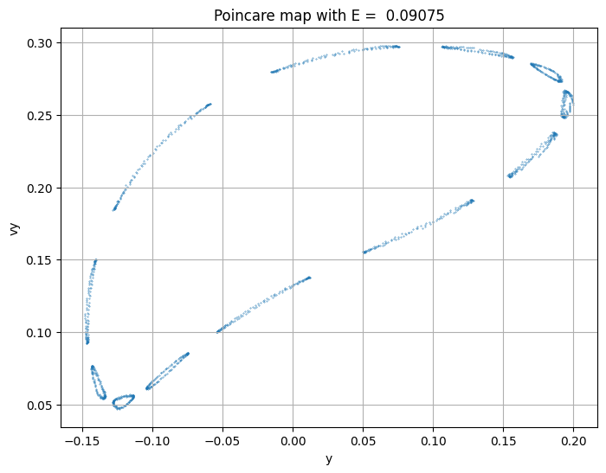
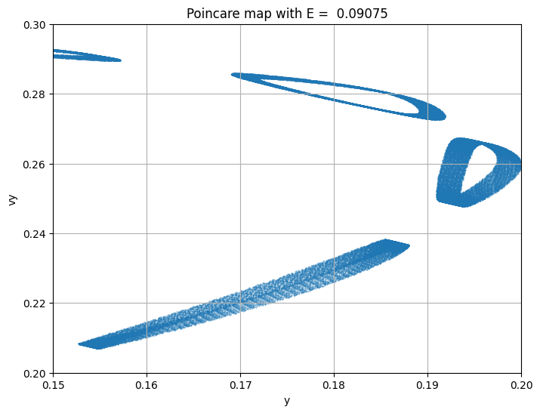
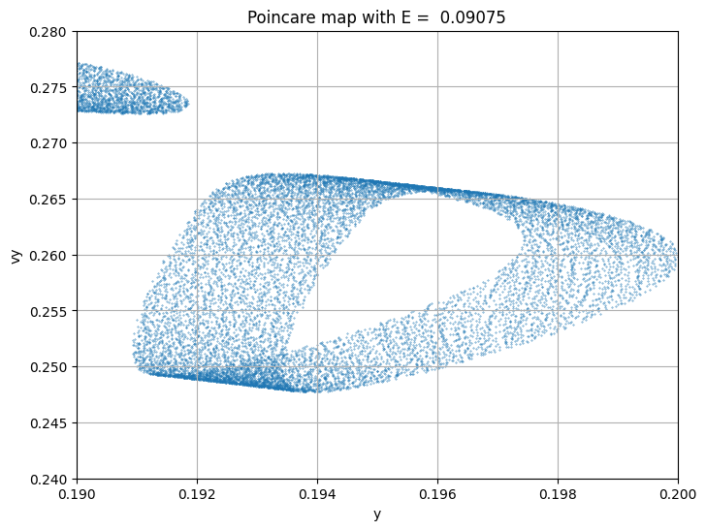
Zoomed In Poincare Map

Slide 19
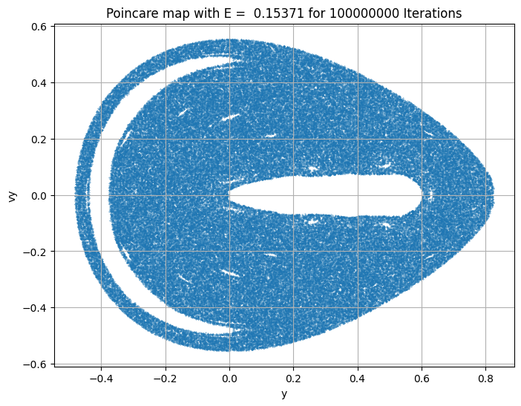
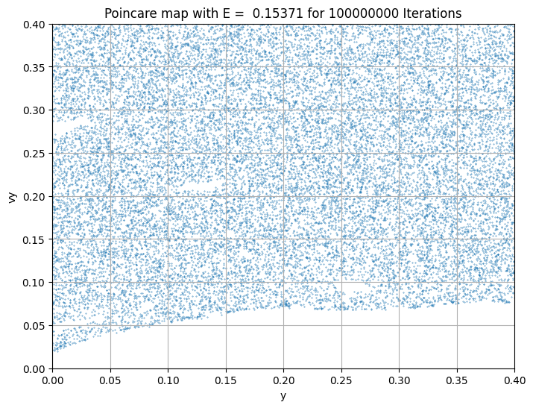
Zoomed In Poincare Map

Slide 20
References
Goldstein, Herbert; Poole, C. P.; Safko, J. L. (2001). Classical Mechanics (3rd ed.). Addison-Wesley. ISBN 978-0-201-65702-9.
Strogatz, Steven, author. Nonlinear Dynamics and Chaos : with Applications to Physics, Biology, Chemistry, and Engineering. Boulder, CO :Westview Press, a member of the Perseus Books Group, 2015.
Henon, M. and Heiles, C., “The applicability of the third integral of motion: Some numerical experiments”, The Astronomical Journal, vol. 69, IOP, p. 73, 1964. doi:10.1086/109234.
Introduction to Modern Dynamics, David D Nolte (Second Edition) https://global.oup.com/academic/product/introduction-to-modern-dynamics-9780198844631?cc=in&lang=en&
Hehe.pdf that we found online https://jfuchs.hotell.kau.se/kurs/amek/prst/11_hehe.pdf
A mechanism explaining the metamorphoses of KAM islands in nonhyperbolic chaotic scattering, Nieto et al (2022) https://link.springer.com/article/10.1007/s11071-022-07623-z

Slide 21

Thank You
Team Member Contributions:
 | Sasi Mitra | Shreya K | Hitesh D | Rasheed SK
Coding | 40 | 20 | 20 | 20
Results | 25 | 25 | 25 | 25
Literature Survey | 25 | 25 | 25 | 25
PPT | 30 | 20 | 30 | 20

